Slide 1
Understanding Life Expectancy Around the Globe
Jarrett Kidd, Vraj Hingoo, Garima Bista, Yejoon Yi, Brayden Radhuber,
Shashank Vanam

Slide 2

Introduction and Research Question
Our research question:
In each region, which variable out of HIV, GDP, Population, and Schooling best explain differences in countries’ life expectancy?
Why these variables?
The set of variables that we used for this question were found to be the most likely predictors when we conducted our preliminary data analysis.

Slide 3
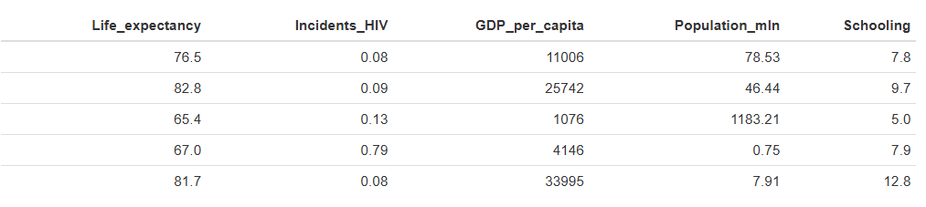
Data Acquisition
The dataset consists of life expectancy, health, immunization, economic, and demographic information from 179 countries ranging from the years 2000-2015.
Schooling information was collected from a project called Our World in Data from The University of Oxford.
Population, GDP, and Life Expectancy were collected from World Bank Data.
Many other variables such as BMI, HIV
Our Dataset: Life Expectancy from the World Health Organization (found via Kaggle)
Variables of Interest for our Question

Slide 4
Statistical Methods
To evaluate which variables best explain regional variance in life expectancy, we utilized both an Ordinary Least Squares (OLS) and Random Forest models on country level data grouped by region.
OLS
Estimates linear relationship between life expectancy and each predictor variable by minimizing the squared difference between observed values and the model's predictions.
Variable importance is determined by magnitude and direction of the standardized Z-Score for each predictor.
Random Forest
Uses a non-parametric method by building “decision trees” based on bootstrap samples and averaging these predictions.
Because of the non-parametric nature of the model, variable importance is determined by percentage increase in Mean Squared Error for each predictor.

Slide 5
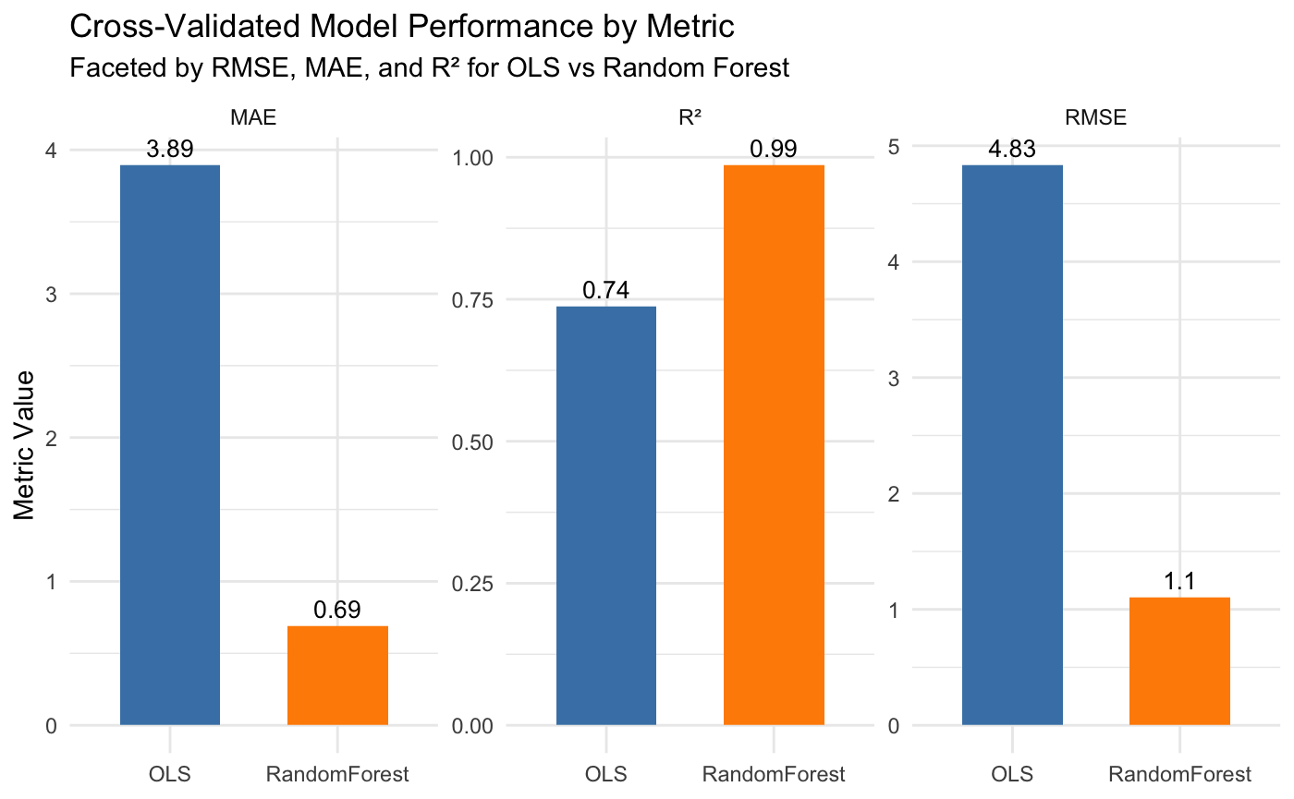
Results

Slide 6
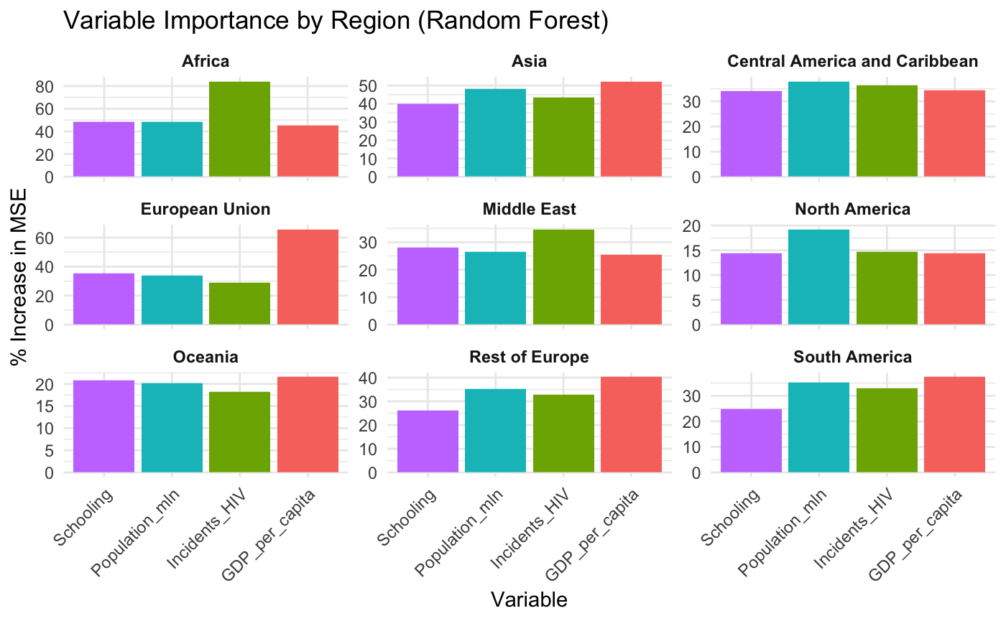
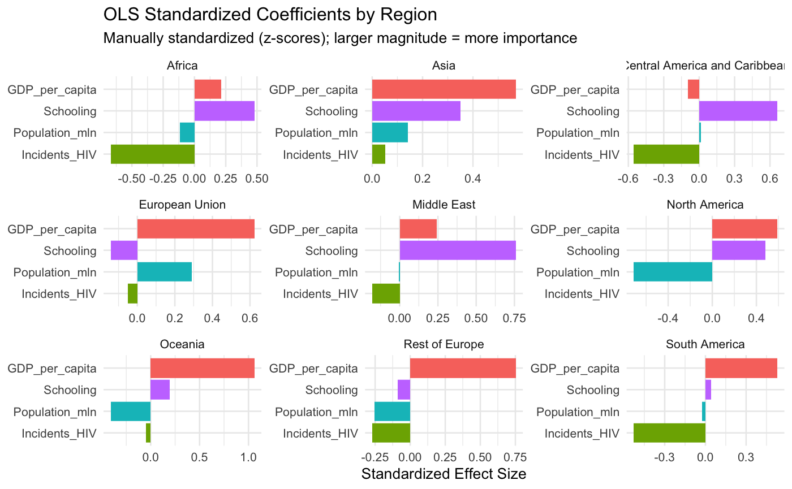
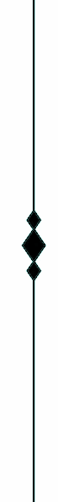
Results

Slide 7
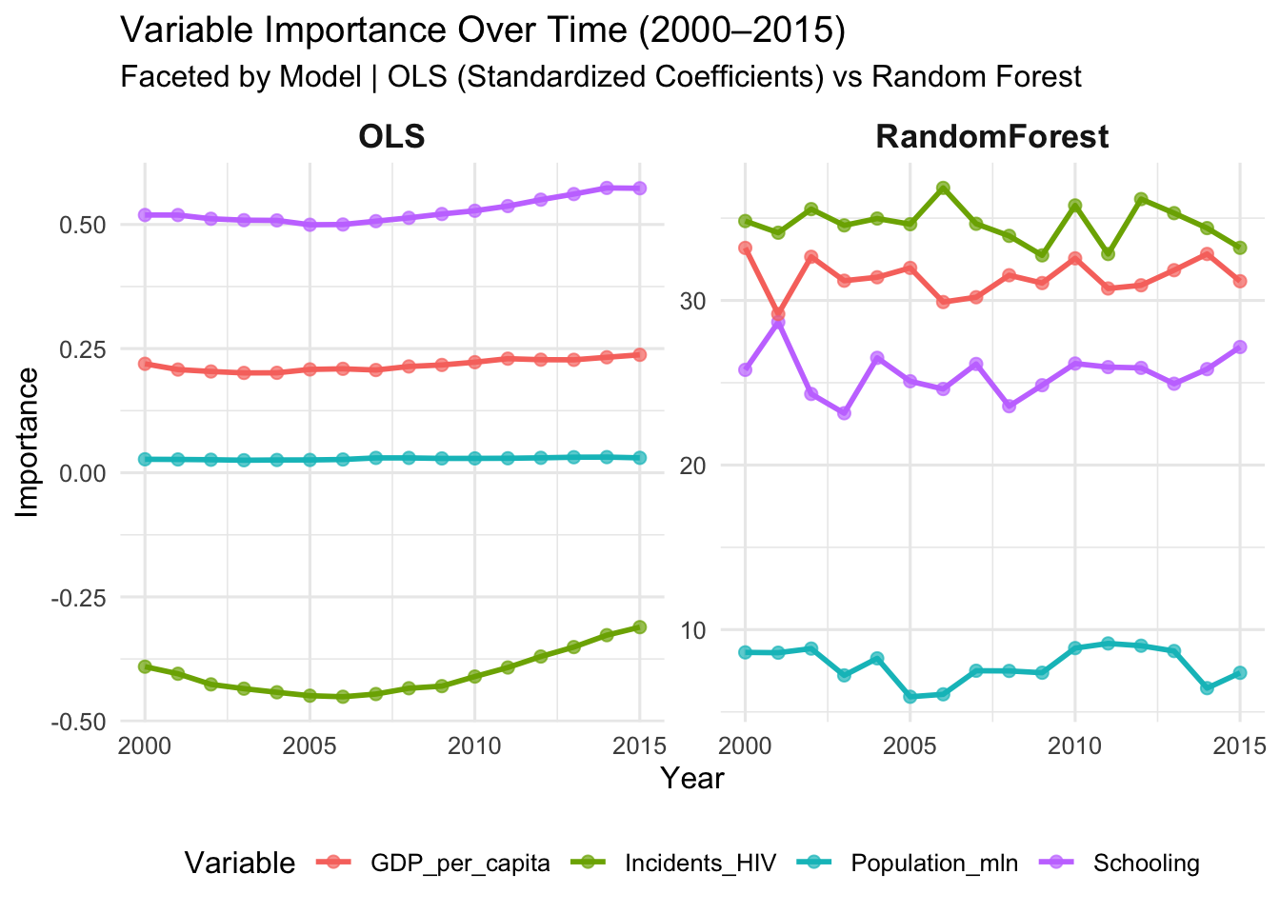
Results

Slide 8
Conclusion
Most important predictor of life expectancy varies by region
OLS model indicates that GDP per Capita has the strongest positive effect on life expectancy in nearly every region
Schooling has a strong positive relationship in most regions, while Incidents of HIV have a strong negative effect in less developed regions such as Africa, Central America, and South America.

Slide 9
Conclusion
Population has minimal impact across most regions, but a somewhat negative relation in more developed areas such as North America, Europe and Oceania.
The Random Forest model mostly reinforces the OLS results.
In Africa, Incidents of HIV are responsible for nearly 80% of the increase in MSE when that variable is omitted, and GDP per Capita remains dominant in Europe.
In general, our results show that there is no single variable that is primarily responsible for predicting life expectancy.

Slide 10
Thank You

